Slide 1


CS 6831 Designing Secure Cryptography
Tom Ristenpart

Slide 2
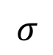
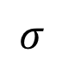
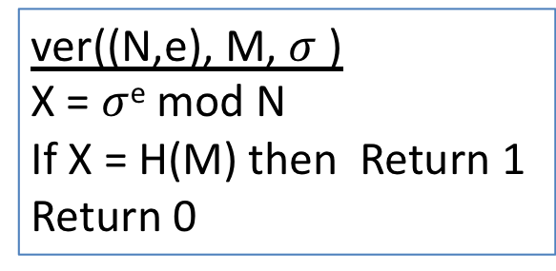
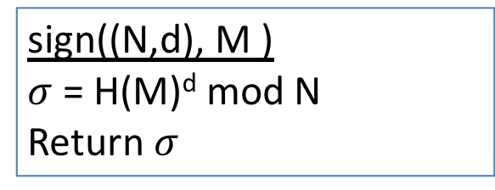
Full Domain Hash RSA
Kg outputs pk = (N,e) , sk = (N,d)
Cryptographic hash function, modeled as RO
(N,d)
sign((N,d), M )
$σ$ = H(M)^{d} mod N
Return $σ$
sign
Technical issue with H:
Depends on public key
In practice fix output length and build H indifferentiable from RO using existing hashes
M
$$σ$$
ver((N,e), M, $σ$ )
X = $σ$^{e} mod N
If X = H(M) then Return 1
Return 0
(N,e)
M
ver
0 / 1
$$σ$$

Slide 3
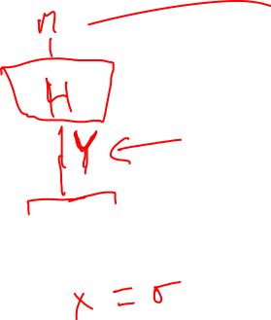

Slide 4
Simplifying assumptions about A:
Always queries H(M) before Sign(M)
Queries H(M*)
Never queries H or Sign twice on same M
Doesn’t query Sign(M*)
Why? Can build such an A’ s.t. adv of A’ at least as much as A’s
A’ has at most q = q_{h} + q_{s} + 1 RO queries

Slide 5
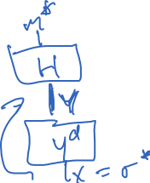
Toy case: 1 RO query and no signing queries
Simply reply with OWF challenge Y to the single H query, which must be on M* (by our restrictions on A)

Slide 6
Toy case: 1 RO query and no signing queries
Simply reply with OWF challenge Y to the single H query, which must be on M* (by our restrictions on A)
Why? Because Y is randomly distributed point, and
Thus, $σ$* is the preimage X of Y, solving OWF game
Challenges for reduction in general case:
Many RO queries, not clear a priori for which message to set H[M] = Y
How do we answer signing queries?

Slide 7
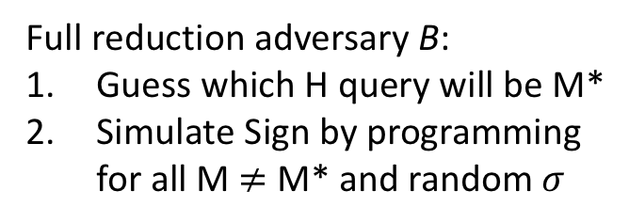
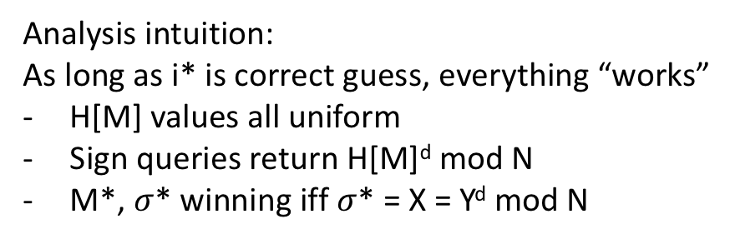
Full reduction adversary B:
Guess which H query will be M*
Simulate Sign by programming
for all M $≠$ M* and random $σ$
Analysis intuition:
As long as i* is correct guess, everything “works”
H[M] values all uniform
Sign queries return H[M]^{d} mod N
M*, $σ$* winning iff $σ$* = X = Y^{d} mod N

Slide 8
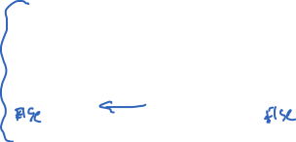

Slide 9
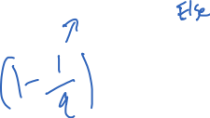
Identical-until-bad arguments we’ve seen won’t quite work here:
Need variant of fundamental lemma
G₀ and G₁ identical-until-bad
good₀ and good₁ be events that bad not set in G₀ and G₁

Slide 10
This argument works:
Recalling q = q_{h} + q_{s} + 1, we get advantage statement
Need variant of fundamental lemma
G₀ and G₁ identical-until-bad
good₀ and good₁ be events that bad not set in G₀ and G₁

Slide 11

Slightly different proof approaches in [Boneh-Shoup] and [Bellare-Rogaway] notes
Concrete security implications?
Notes:
q_h is number of hash computations allowed to adversary A. So could be close to 2⁸⁰, for theorem to apply need to set k to be larger
Say Adv(B) = (1/2)^40 for for some RSA key size k and time allotment t. (Can estimate via NFS algorithm runtime) But now if q_h = 2^80 then we have a problem. So need to set RSA key size k bigger if we want theorem guarantee to hold
But no attack seems to work better than solving RSA. Nevertheless can we get a better proof?

Slide 12
Slightly different proof approaches in [Boneh-Shoup] and [Bellare-Rogaway] notes
Clever proof approach using random self-reducibility of RSA
Key idea: embed OWF challenge Y in multiple H[M] values
See [Boneh-Shoup] for details
Notes:
q_h is number of hash computations allowed to adversary A. So could be close to 2⁸⁰

Slide 13

Tight reductions to RSA?
Can we get even better reductions?
Still factor q_{s} multiplicative loss in advantage. Would prefer:
for tiny epsilon
Probabilistic signature scheme (PSS) [Bellare, Rogaway 1996]
Randomizes signing (add random salt to FDH hash)
Allows tight proof
Coron shows negative result for schemes with “unique” signatures
PRF-based variant [Katz, Wang 2003]
Sidesteps negative result to build deterministic (but not unique) signature scheme
Clever use of a PRF: H(F(K,M),M)^{d} mod N
F’s range is just a single bit!

Slide 14
Discrete-log signatures
We’ll show some DL schemes, and then defer analysis until next lecture. See the house, then how to build it!
Turns out there’s a rich connection between:
Identification schemes (how to authenticate yourself to someone else)
(Honest-verifier) zero-knowledge proofs
Digital signatures

Slide 15
Groups for Schnorr and DSA Signatures
Let p be a large prime number
Let q be a prime such that q divides p-1
Example: p = 2q + 1 (so-called safe prime p)
Fix the group G = Z_{p} = {1,2,3,…, p-1}
Let g be generator of sub-group of order q:
Can also use ECC groups instead
*
{ g⁰, g¹, g², … , g^{q-1} } subset of G

Slide 16
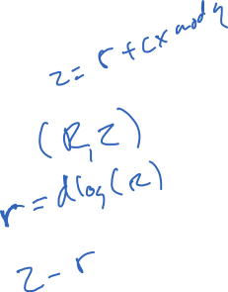
(Variant of) Schnorr signatures
p,q,g specified
sk = x chosen randomly from Z_{q} pk = X = g^{x}
Sign(x, M )
r <-$ Z_{q}
R = g^{r} ; c = H(M || R) ; z = r + cx mod q
Return (R,z)
Ver(X, M, (R,z) )
c = H(M || R)
If g^{z} = RX^{c} then Return 1
Return 0
Correctness?
g^{z} = g^{r + cx} = g^{r}g^{xc} = RX^{c}

Slide 17
Fragility of Schnorr signatures
Repeat randomness failure:
Sign two messages M ≠ M’ and reuse randomness r
Sign(x,M) -> (R,z)
Sign(x,M’) -> (R,z’)
= (R, r + cx mod q)
= (R, r + c’x mod q)
Then: x = (z - z’) / ( c - c’ ) = (z - z’) / ( H(M||R) - H(M’||R) )
If r is predictable/leaked, can recover secret from (R,z)
Side point: can improve security by “hedging”:
choose r = H( x || M || randomness )

Slide 18
Security analysis intuition
H modeled as RO -> c values random
Assume an adversary that can output forgery (M,(R,z))
Then to be valid:
g^{z} = RX^{c} implies z = r + cx
for c = H(M || R) .
Imagine we can run adversary twice but force forgery to be on same R, different c (re-run adversary, program RO)
In second execution, get (M’,(R,z’))
Then success second time around gives:
g^{z’} = RX^{c’} implies z’ = r + c’x
But now can compute z - z’ / (c - c’) = x the secret key . Solved DL!

Slide 19
Actual Schnorr signatures
p,q,g specified
sk = x chosen randomly from Z_{q} pk = X = g^{x}
Sign(x, M )
r <-$ Z_{q}
R = g^{r} ; c = H(M || R) ; z = r + cx mod q
Return (c,z)
Ver(X, M, (c,z) )
R’ = g^{s} X^{-c}
c' = H(M || R)
If c’ = c then Return 1
Return 0
Correctness?
R’ = g^{s}X^{-c} = g^{r + cx} g^{x/(H(M||R))} = g^{r}

Slide 20
DSA (digital signature algorithm)
p,q,g specified
sk = x chosen randomly from Z_{q} pk = X = g^{x}
Sign(x, M )
r <-$ Z_{q} ; R = (g^{r} mod p) mod q
z = r ⁻¹ ( H(M) + x R ) mod q
Return (R,z)
Ver(X, M, (R,z) )
w = z⁻¹ mod q
u1 = H(m) * w mod q
u2 = R*w mod q
If R = (g^{u1} X^{u2} mod p) mod q
then Return 1
Else Return 0
Correctness?
g^{u1} X^{u2} = g^{H(M) w} g^{x R w} = g^{(H(M)+xR) w}
= g^{(H(M)+xR) (H(M)+xR) r} = g^{r}
-1

Slide 21
Fragility of DSA
Repeat randomness failure:
Sign two messages M ≠ M’ and reuse random r
Sign(x,M) -> (R,z)
Sign(x,M’) -> (R,z’)
= (R, r ⁻¹ ( H(M) + x R ) mod q )
= (R, r ⁻¹ ( H(M’) + x R ) mod q )
Then: Solve for r ⁻¹, solve for x
If r is predictable/leaked, can recover secret from (R,z)
Again, can improve security by “hedging”:
choose r = H( x || M || randomness )
https://tools.ietf.org/html/rfc6979

Slide 22
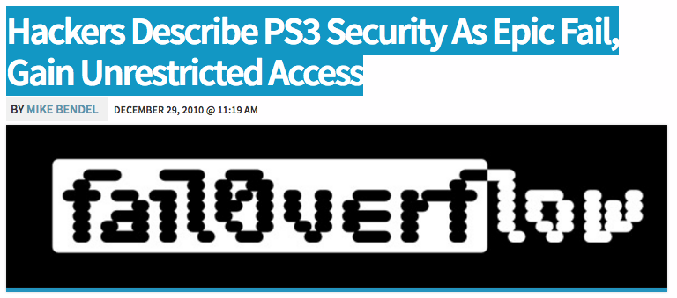
http://psx-scene.com/forums/content/sony-s-ps3-security-epic-fail-videos-within-581/

Slide 23

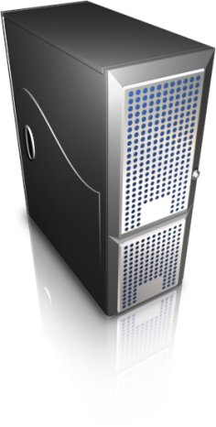
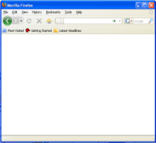




Another example randomness reuse:
Virtual machines reset vulnerabilities
Virtual machine (VM) encapsulates entire guest operating system
and (virtualized) hardware resources
VM manager
VM snapshots save entire state (memory, persistant
storage, etc.) of a VM
Backup
Migration
Replication
Fault or intrusion recovery
Volume snapshots (as used in EC2) only save persistant storage.
OS must be booted

Slide 24



Another example randomness reuse:
Virtual machines reset vulnerabilities
In some situations using Apache mod_ssl inside VMs:
DSA
secret
key
https://www.mybank.com/
TLS key
exchange
https://www.mybank.com/
TLS key
exchange
Key extraction is possible
DSA secret key allows
impersonating server
Notes:
when able to connect to server right after running from snapshot

Slide 25

https://www.mybank.com/
DSA
secret
key
TLS key
exchange
A logical timeline of events
HTTPS request
handled by a child
Adminstrator
launches
Apache
daemon
Childs’
RNGs
init’d
DSA
signing
Randomness used to sign
key exch msg
sk_{server}
Sign
Apache children processes forked
User snapshots VM
RNG updated
with time, child PID, stack
sig
Snapshot later run.
sig sent to client

Slide 26

https://www.mybank.com/
DSA
secret
key
TLS key
exchange
A logical timeline of events
VM clock
synch
HTTPS request
handled by a child
VM managers often
synchronize guest’s
time with Internet
DSA
signing
Randomness used to sign
key exch msg
Guests’
network up
This would seem to
imply that DSA
randomness
would be different
each time
sk_{server}
Sign
User snapshots VM
RNG updated
with time, child PID, stack
sig
Snapshot later run.
sig sent to client

Slide 27
Experimenting with DSA key extraction
DSA
secret
key
TLS key
exchange
TLS key
exchange
TLS key
exchange
This is one trial.
We performed 5 trials for each VMM without rebooting physical server
We performed 5 trials for each VMM with rebooting physical server
Looked for reuse of randomness across pairs of successful connections

Slide 28
Discrete-log signatures
We’ll show some DL schemes, and then defer analysis until next lecture. See the house, then how to build it!
Turns out there’s a rich connection between:
Identification schemes (how to authenticate yourself to someone else)
(Honest-verifier) zero-knowledge proofs
Digital signatures

Slide 30
Let p be a large prime number
Let q be a prime such that q divides p-1
Example: p = 2q + 1 (so-called safe prime p)
Fix the group G = Z_{p} = {1,2,3,…, p-1}
Let g be generator of sub-group of order q:
How to pick g?
g = h^{(p-1)/q} mod p for some h and check g ≠ 1 mod p
If so, try repeat with another h. Usually use h = 2
Can also use ECC groups instead

